Slide 1
Title
Student’s name
University of Maryland School of Nursing
Notes:
Title should be consistent with title of DNP project manuscript
Avoid line breaks in the title in the middle of prepositional phrases or between adjectives modifying nouns
Do not use any abbreviations in title
Font size of title should be at least 40 pt

Slide 2
Introduction
List the topics you plan to cover in this presentation
Notes:
Topics might include Background
Purpose Statement
Literature Review
Theoretical Framework
Procedures
Data Collection
Data Analysis
Human Subjects Protection

Slide 3
Problem Statement
Include the significance of the problem
Notes:
Bullets:
Use bulleted text because bulleted items are easier to read than full sentences
Each bullet point must be a concise summary of what you state verbally
Keep bulleted item to no more than ten words per line
Keep slide to a maximum of seven lines of bulleted text per slide
Use font size 22 to 26 pt
Offer only brief definitions, if needed, and no more than one per slide
Use of citations:
APA format for citations does not pertain to slides
Citations usually include first author and year within parentheses in smaller 12 to 14 pt
If one citation supports content of entire slide, it may be placed in separate box at bottom of slide

Slide 4
Purpose Statement
The purpose of this quality improvement project was to implement….
Goals
  Short-term
  Long-term
Notes:
Purpose statement should be consistent with statement in the DNP project manuscript and describe the practice change that was implemented
Abbreviations should be avoided
Follow the purpose statement with one or two short- and long-term goals
The short-term goals would be those that are to be completed during project implementation, and are often process goals
The long-term goals would be those that are to be completed up to one year after implementation and are usually patient outcome goals.

Slide 5
Literature Review
Provide a synthesis of the literature that supports the practice change
Notes:
Include on most significant citations with author and year.
APA format is not required for PowerPoint presentations

Slide 6
Theoretical Framework
Precontemplation
Contemplation
Determination
Action
Relapse
Maintenance
Enter
Stages of Change Model
Notes:
Framework best if presented as a diagram or graphic as opposed to only text

Slide 7
Methods
Quality Improvement Project
Sample - add inclusion & exclusion criteria
Setting - protect the identity
Notes:
Note that it was a Quality improvement project (as opposed to a research study)
May add inclusion/exclusion criteria for sample (or if multiple criteria, may choose to show on separate slide)
Do not identify setting by name, but rather by description without identifiers

Slide 8
Data Collection
Structure measures (e.g., change in EHR, percentage of staff trained in new practice)
Process measures (e.g., chart audits, checklists, observations, interviews)
Outcome measure (e.g., fall rates, infection rates, HCAHPS Scores)
Notes:
Describe Structure, Process and Outcome measures

Slide 9
Ethical Considerations
Project received a Non Human Subjects Research determination from the University of Maryland Baltimore Institutional Review Board
Projects was also approved by organization’s . . .
Examples of strategies used to protect human subjects:
  Voluntary participation
  No identifiers collected
  Surveys collected in secure box
  Anonymous surveys collected electronically via SurveyMonkey
  Electronic data kept on password protected computer
  Paper questionnaires stored in locked file cabinet.
Notes:
Include reviews that were required by the organization if project is being implemented outside of the UMB system
Described any other ethical considerations

Slide 10
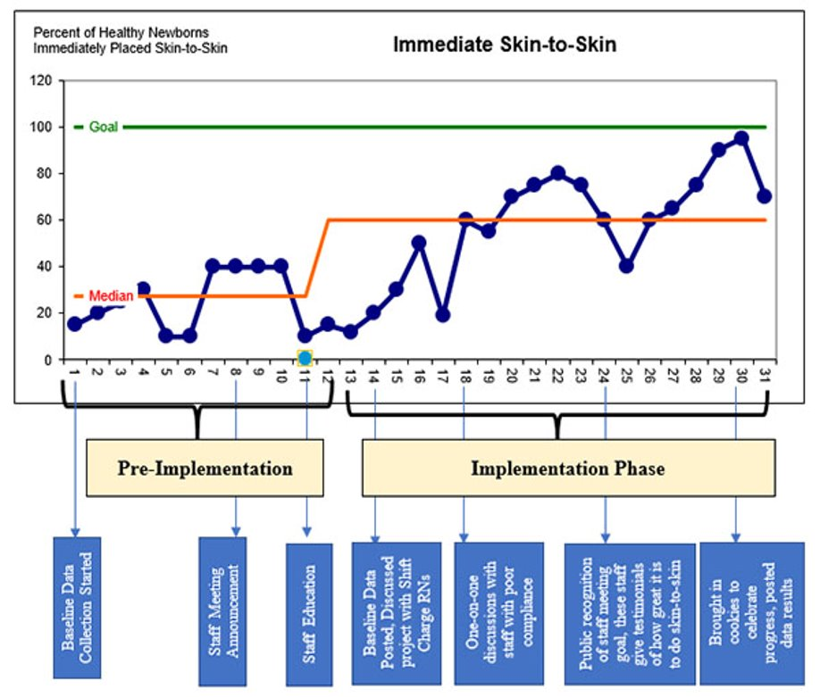
Results
Notes:
Results should include:
report of changes in practices that were made (structures and processes) as evidenced by analysis of measures (data)
observed associations among interventions, outcomes and relevant contextual elements
unintended consequences such as unexpected benefits, facilitators, barriers, problems, failures, or costs encountered and associated with the intervention(s)
Present results in tables and figures in the order discussed in your final report
Present one table or figure per slide

Slide 11
Discussion
Association between the interventions and outcomes
Comparison of results with findings reported in publications
Reasons for differences between observed and anticipated outcomes
Limitations
Notes:
Discussion may include
an interpretation of the association between the intervention(s) and the outcomes
comparison of results with findings from other publications
reasons for any differences between observed and anticipated outcomes, including the influence of context
limitations to the generalizability of the findings, the design of the project (e.g., factors that might have limited internal validity such as bias or imprecision in the project design, methods, measurement, or analysis), and any efforts made to minimize and adjust for limitations

Slide 12
Conclusions
Usefulness and relevance of work
Sustainability and spread
Implications of findings for practice
Notes:
Conclusions should include:
usefulness and relevance of the work to health care delivery, patient outcomes and quality of health care
particular strengths of the project including mechanisms for sustainability of practice change that have been put in place and potential for spread to other contexts
implications for practice, future QI projects, and education

Slide 13
References
Notes:
Include only references cited within presentation

Slide 14
Acknowledgements
Notes:
Acknowledge your project faculty advisor and others at the practice site who supported the project, provided you have their permission.

